Slide 1
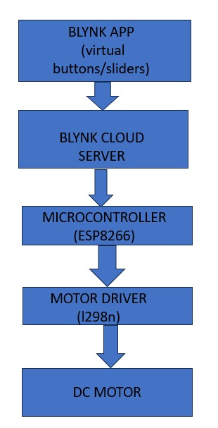
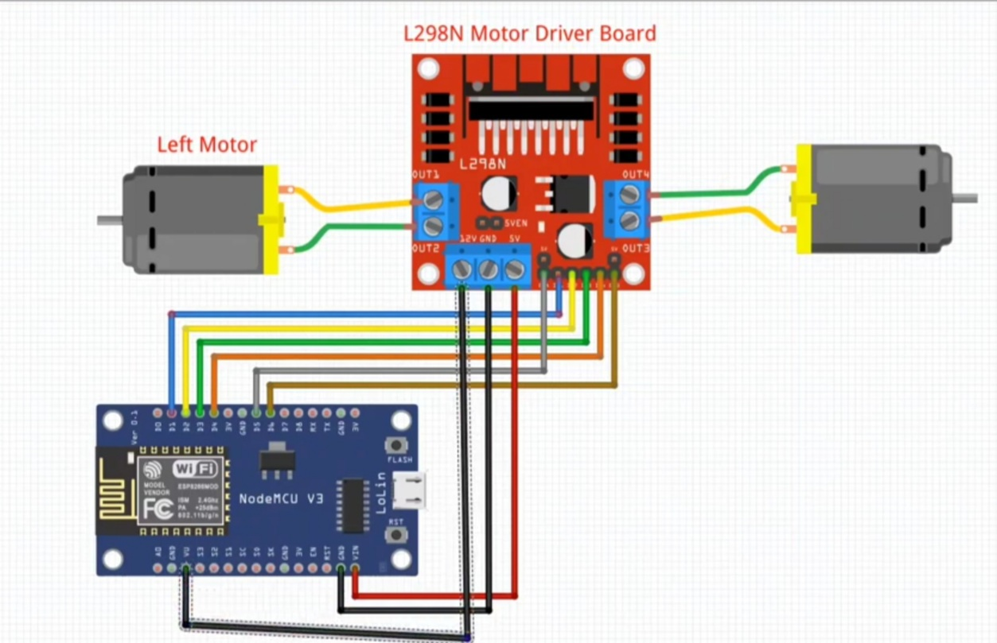
II B. Tech. II Sem. (AY: 2023-24)
Poster Presentation
EE-299 (Mini Project - I)
Date: 03-05-2024 (10:00 A.M. to 01:00 P.M.)
Venue: ABJ Laboratory Complex
Title : IOT Based Speed Control of DC Motor
Problem Statement:
To develop a system that allows users to remotely control the speed of a DC motor using a WiFi module.
In various applications, there's a need for remotely controlling the speed of DC motors. Traditional methods often involve manual adjustments or wired connections, which can be inconvenient or impractical, especially in scenarios where the motor is located in a remote or inaccessible area. To address this issue, the project aims to implement a wireless solution using WiFi technology.
Block Diagram:
Abstract:
This project presents a novel approach to remotely control the speed of a DC motor using a WiFi module and an ESP8266 controller. The system leverages the ubiquity of WiFi networks to enable seamless communication between a mobile device or computer and the ESP8266 controller, allowing users to adjust the motor's speed wirelessly from anywhere within the network range. Through a user-friendly interface, implemented via a web server hosted on the ESP8266, users can set desired speeds and receive real-time feedback. The ESP8266 controller interprets these commands and adjusts the motor's speed accordingly, offering a versatile and convenient solution for applications ranging from home automation to industrial control systems.
Result:
The results of the project demonstrate the successful implementation of a wireless speed control system for DC motors using a WiFi module and an ESP8266 controller
Conclusion:
In the development of a wireless speed control system for DC motors using a WiFi module and an ESP8266 controller has been successfully achieved. Through meticulous requirement analysis, careful component selection, and systematic methodology, the project has delivered a robust and versatile solution that addresses the needs of modern automation and remote control applications. The intuitive web interface hosted on the ESP8266 controller provides users with seamless access to motor speed adjustment and real-time feedback, enhancing user experience and control precision. Moreover, the incorporation of safety features ensures user safety and equipment protection, further enhancing the reliability and usability of the system. With comprehensive documentation and ongoing user support, the project is poised to make a significant impact in various domains, including home automation, robotics, and industrial control systems. Moving forward, continued refinement and enhancement of the system based on user feedback will further solidify its position as a leading solution for wireless motor speed control.
Objective:
The objective of this project is to develop a wireless speed control system for DC motors using a WiFi module and an ESP8266 controller. The primary goal is to enable users to remotely adjust motor speed from any device within the network range, enhancing flexibility and convenience in motor control. This entails designing an intuitive web interface hosted on the ESP8266 controller to facilitate user interaction and speed adjustment, while also implementing mechanisms for real-time feedback on the current motor speed status. Additionally, safety features will be incorporated to prevent accidents or damage, ensuring user safety and equipment protection. Compatibility with various DC motor types and applications, reliability in handling network fluctuations, scalability for future enhancements, and comprehensive documentation and support resources will be prioritized to deliver a robust and versatile solution that meets the diverse needs of modern automation and remote control applications.
Keywords :
Here are some keywords related to the project:
1.WiFi Module 2.ESP8266 Controller 3.DC Motor 4.Speed Controller 5..Mobile App 6..Motor Driver Circuit
Introduction:
The project aims to revolutionize the traditional method of controlling DC motors by introducing a wireless speed control mechanism utilizing a WiFi module and an ESP8266 controller. In today's era of smart technologies, the ability to remotely manage devices is becoming increasingly indispensable, spanning from home automation to industrial applications. By harnessing the power of WiFi connectivity, this project enables users to control the speed of a DC motor wirelessly from any device within the network range .Traditionally, controlling the speed of a DC motor required physical interaction with the motor's control interface, limiting its application in scenarios where remote or automated control is desired. With the integration of a WiFi module and an ESP8266 controller, this project eliminates such limitations, offering users unprecedented flexibility and convenience in motor speed adjustment. The project not only emphasizes convenience but also prioritizes user experience and safety. Through a user-friendly web interface hosted on the ESP8266, users can intuitively set the desired speed of the motor and receive real-time feedback, ensuring precise control and monitoring. Moreover, safety features are implemented to prevent accidents or damage, further enhancing the reliability and usability of the system. With its versatility and ease of integration, this project holds immense potential across various domains, including home automation, robotics, and industrial control systems. The following sections delve deeper into the hardware and software components, control mechanism, user interface, safety measures, and potential applications of this innovative speed control system.
References:
1.R. Mancini, Op Amps for Everyone, Texas Instruments, 2002.Show in Context Google Scholar
2."Data Sheet LM78XX/78XXA 3 Terminal 1 A Positive Voltage Regulator", March 2008.Google Scholar
3)IOT based control of DC traction motor Akankshal, Shubham Kathuria2 1,2 School of Electrical Engineering, VIT Chennai Tamil Nadu 600127, India University,
4) Speed Control of DC Motor by using IoTPratima A. Uparwat1, Lalit
Proposed Methodology:
1)Requirement Analysis: Conduct a thorough analysis to understand the project requirements, including the desired functionalities, user interface specifications, safety considerations, and compatibility requirements with different types of DC motors.
2)Component Selection: Select appropriate hardware components, including the WiFi module, ESP8266 controller, motor driver circuit, and any additional peripherals required for the project. Consider factors such as compatibility, reliability, and availability.
3) System Design: Design the system architecture, including the communication protocol between the ESP8266 controller and the user interface, the motor control mechanism, the safety features, and the real-time feedback system. Define the data flow and interaction between different components of the system.
4)Web Interface Development: Develop an intuitive web interface hosted on the ESP8266 controller using suitable programming languages and frameworks. Design the interface to allow users to set motor speed easily and receive real-time feedback on the current speed status.
Circuit Diagram:
Presentation By: 1.G.Navya Sree(522131)
2.G.Sushma(522132)
3.G.Chaitanya(522128)
4.K.Rahul Goud(522143)
Supervisor:
Mr. B.V Surya Raghava

